Slide 1
RNA-Seq Analysis for data from paper “Rinf regulates pluripotency network and Tet enzymes in embryonic stem cells”
Overview:
Investigate the role of Rinf in differentiation and lineage specification programs of ESCs by analyzing the transcriptomic profile of wild type and Rinf–/– ESCs during differentiation to embroyoid bodies (EBs) at three time points (day 0, 3, 6).
Goals of analysis:
Find differentially expressed genes between wild type and knock out samples over the course of day 0, day 3, and day6.

Slide 2
Pipeline and Steps
Input with
Raw Data
Data Trimming
(Trim-Galore 0.6.5)
Map to Genome
(TopHat 2.1.1)
Calculate FPKM
(Cufflinks 2.2.1)
Count Reads
(HTseq Count 0.6.1)
Extract genes with FPKM > 1 (awk)
Extract counts for FPKM >1 genes
Plots for DEGs
(Vennerable, ggplot2, ComplexHeatmap)
Call DEGs
(Deseq2)
GO Analysis
(David 6.8)

Slide 3
All Codes Used
# Alignment
tophat -p 4 -G $genomedir/$gtf -o $mappingdir/${sample}_tophatout $genomedir/mm10 $indir/${sample}.fastq.gz
# Index the bam
samtools index $mappingdir/${sample}_tophatout/accepted_hits.bam
# HTseq Count
htseq-count -f bam --stranded=no -r name $mappingdir/${sample}_tophatout/accepted_hits.bam $genomedir/$gtf > $htseqresults/${sample}.htseq.txt
# Calculate RPKM
cuffdiff $genomedir/$gtf <above renamed bam files with spaces>
#Deseq2
dds = DESeqDataSetFromMatrix(cMatrix, myCond, design = ~ condition)
#Code location
\Rinf\Code\tophat_htseq.sh.txt
\Rinf\Code\cuffdiff.sh.txt
\Rinf\Code\htseq_EB.R.txt
\Rinf\Code\Plots.R.txt
\Rinf\Code\bigwig.sh.txt

Slide 4
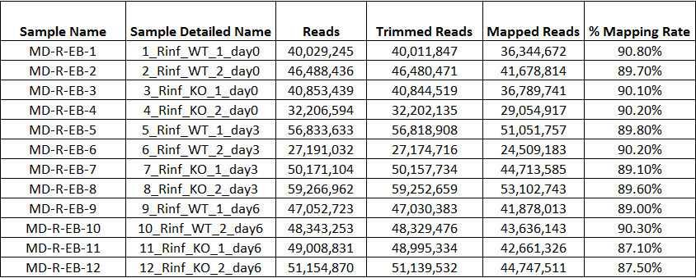
Trimming and Mapping Stats

Slide 5
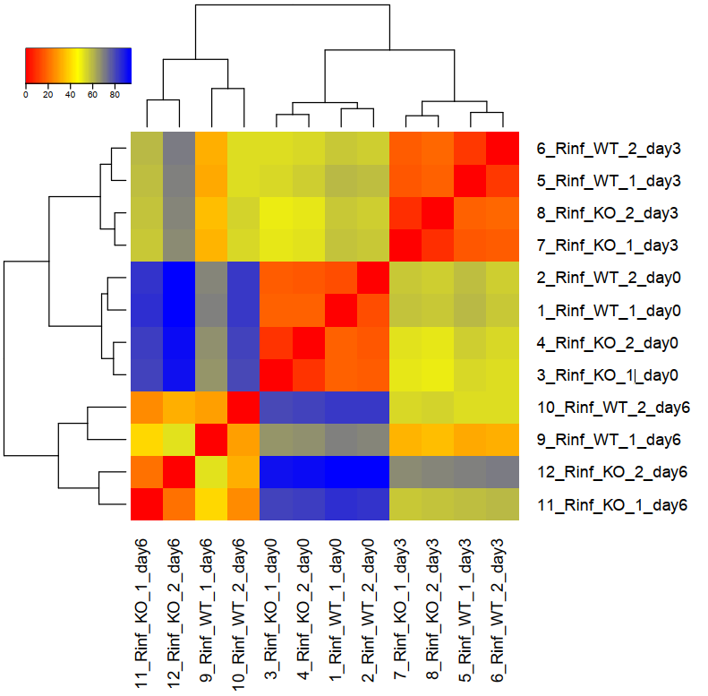
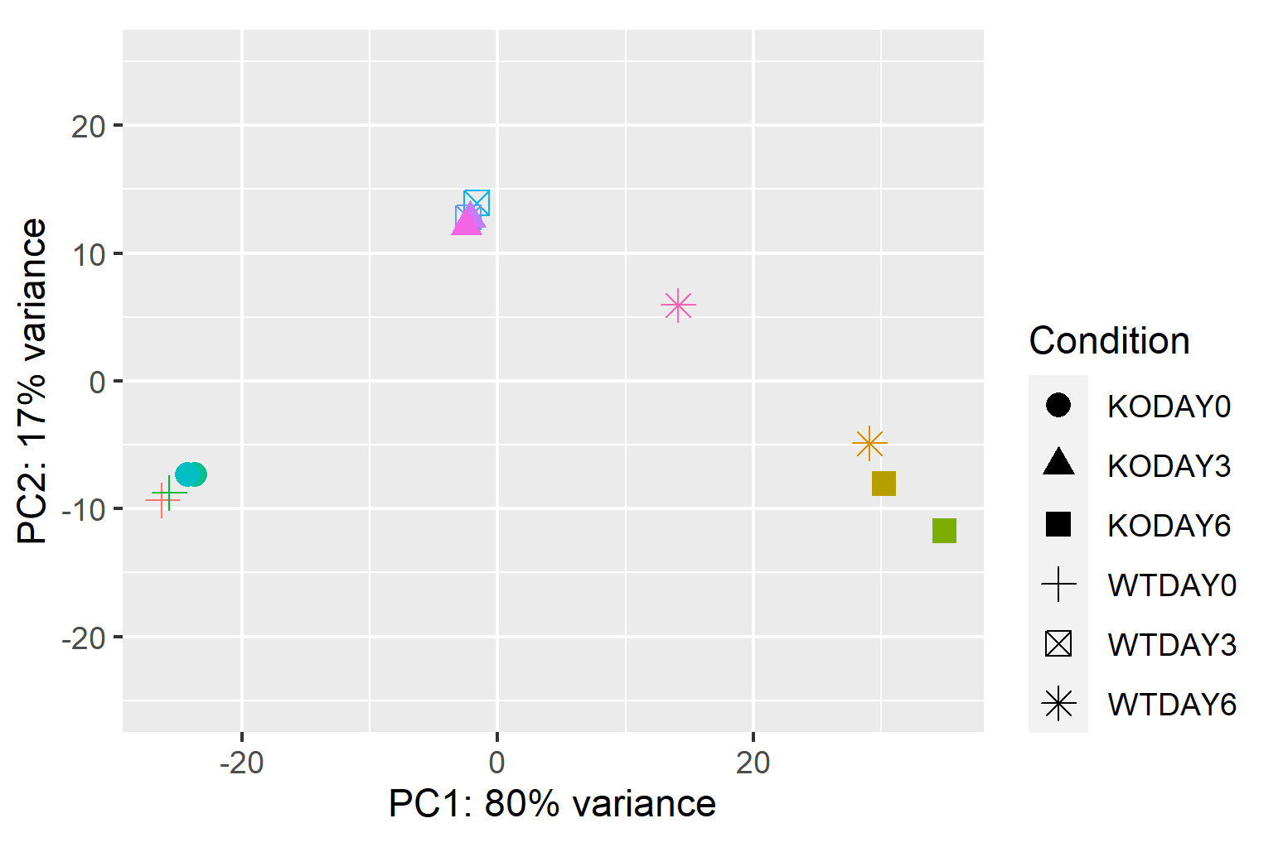
PCA Analysis of Samples
Sample Distance Heatmap Plots
Day 3
Day 0
Day 6

Slide 6
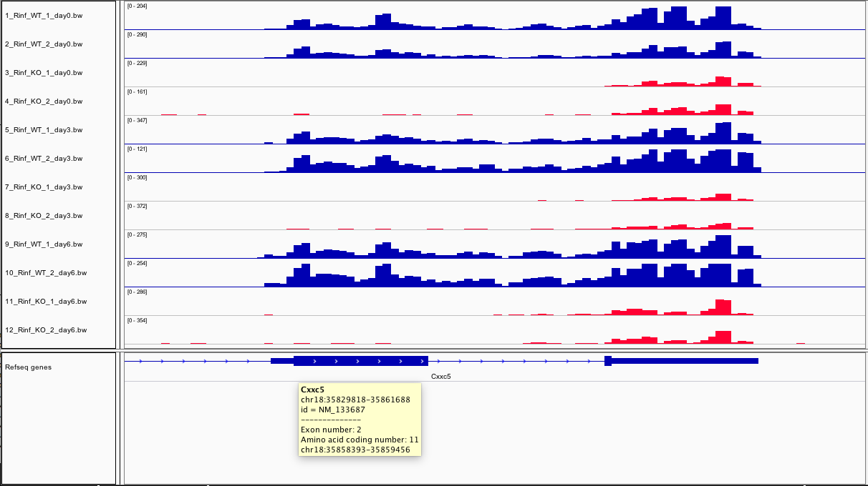
IGV shows Rinf (Cxx5) has Exon 2 deleted

Slide 7
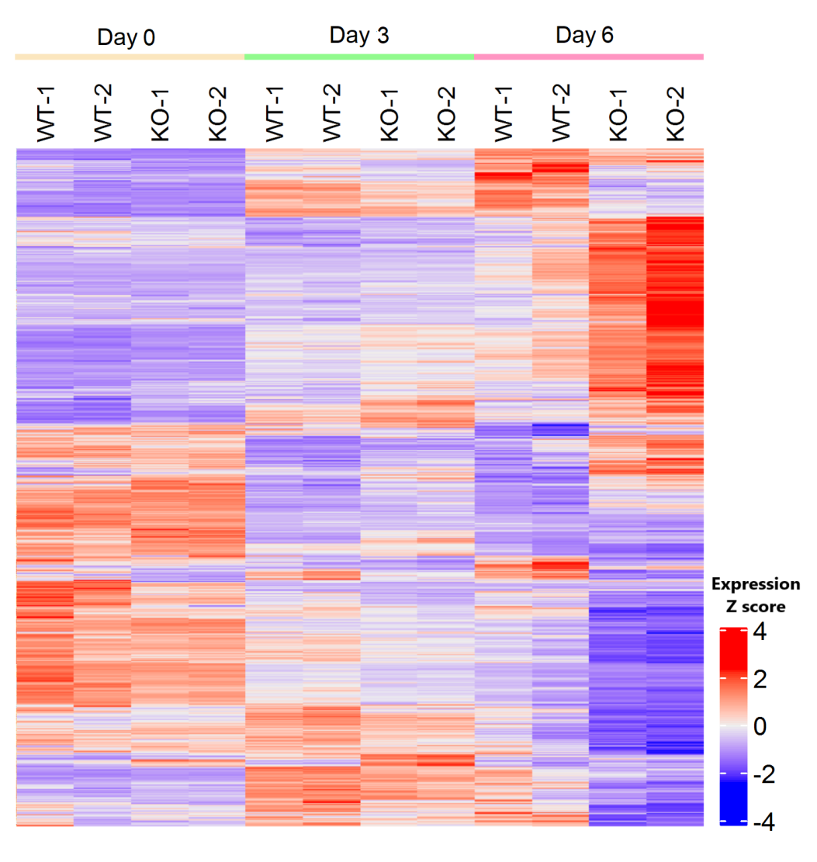
Heatmap of DEGs identified at the indicated time points during differentiation to EBs

Slide 8
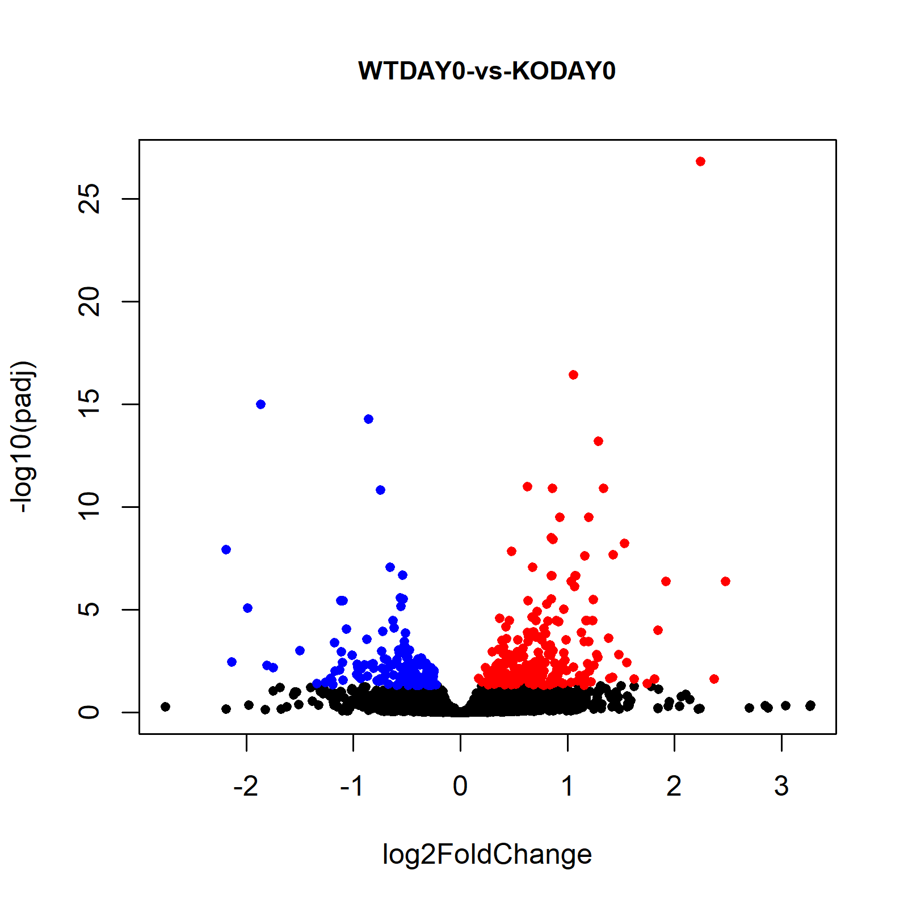
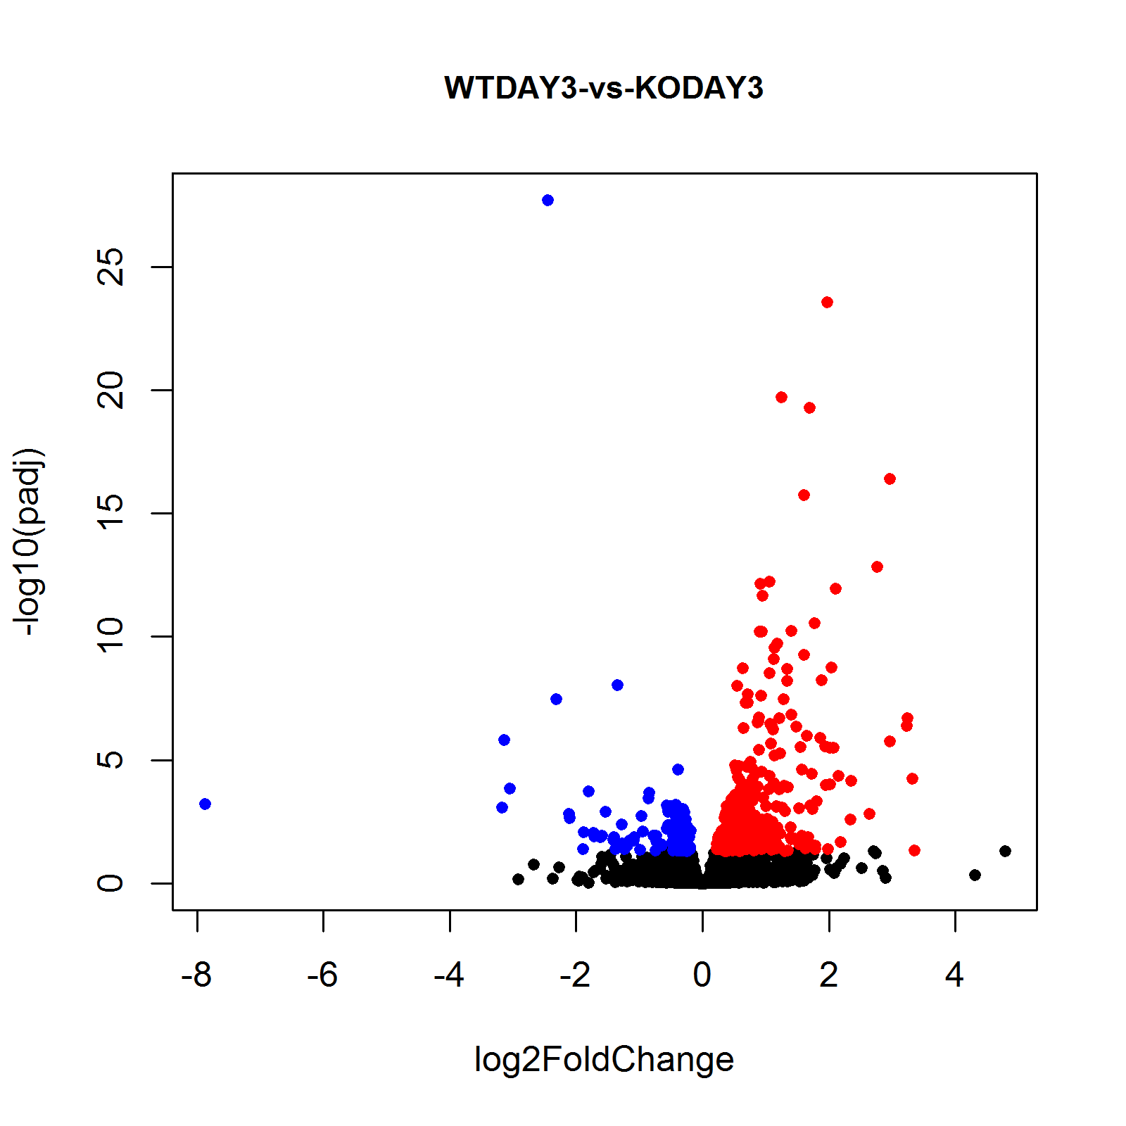
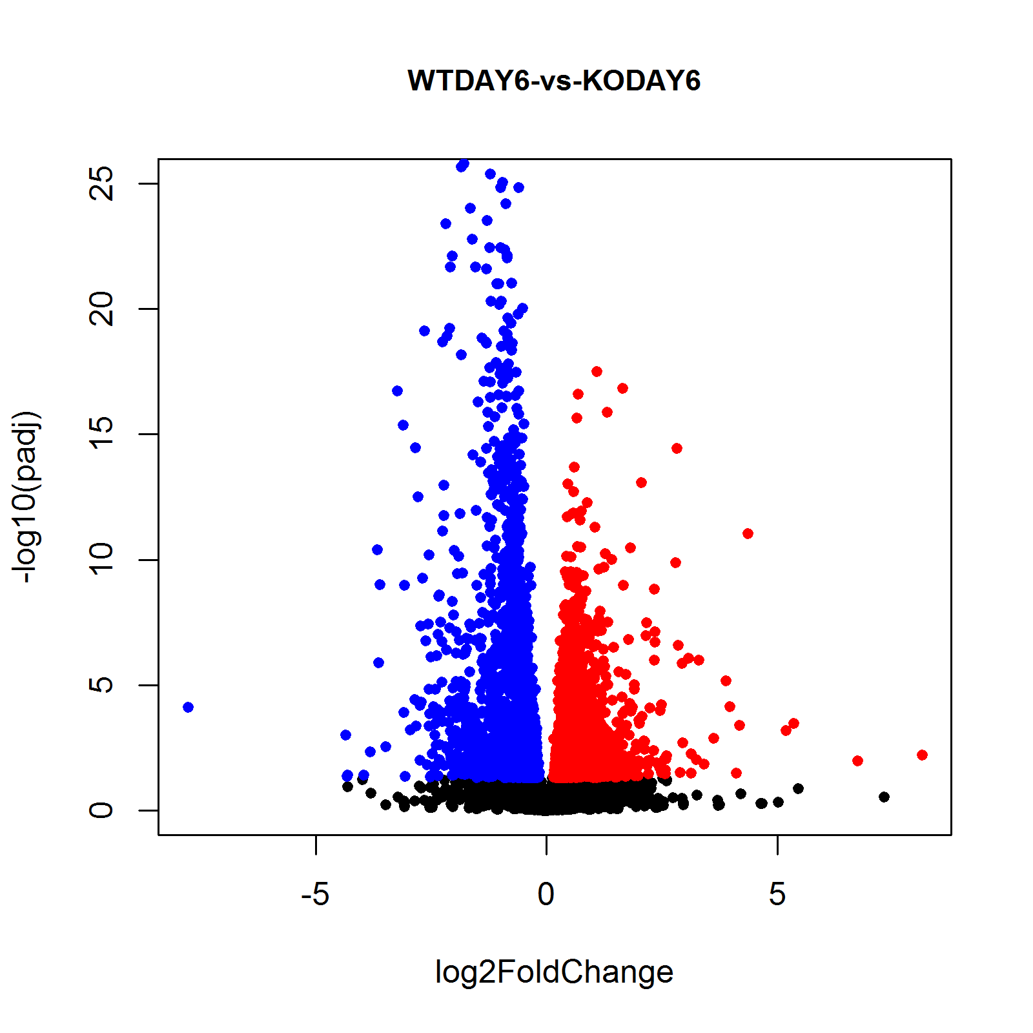
Volcano Plots

Slide 9
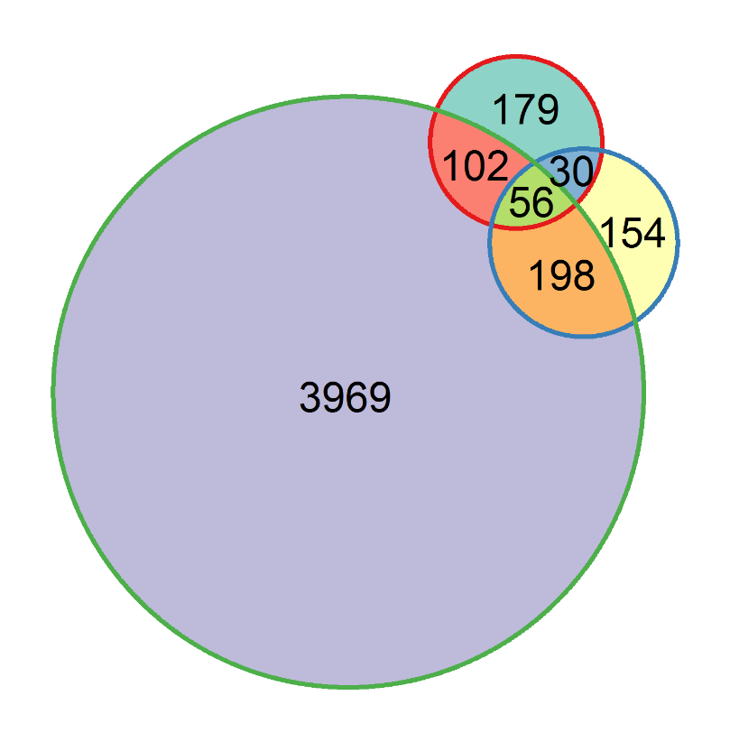
Venn diagram illustrating overlap of DEGs between wild-type and Rinf–/– EBs for each time point during differentiation.
Day 0
Day 3
Day 6

Slide 10
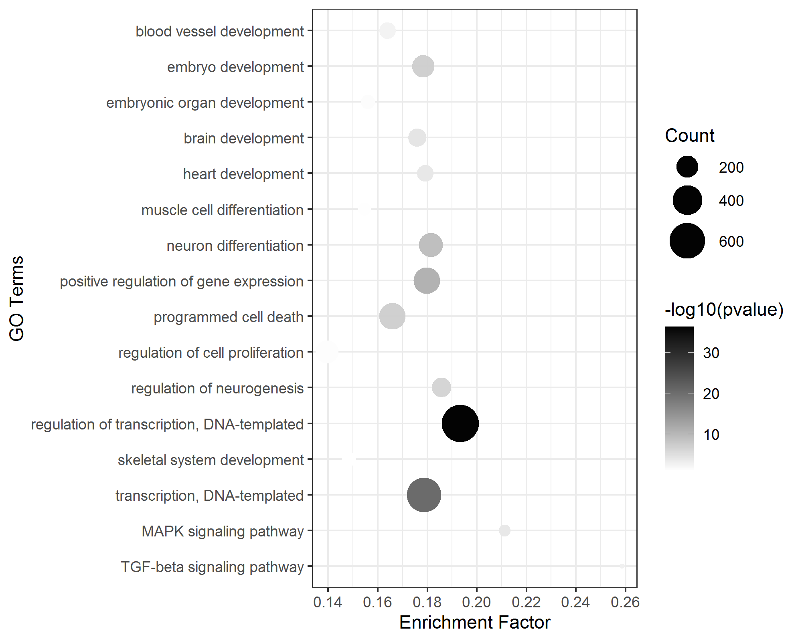
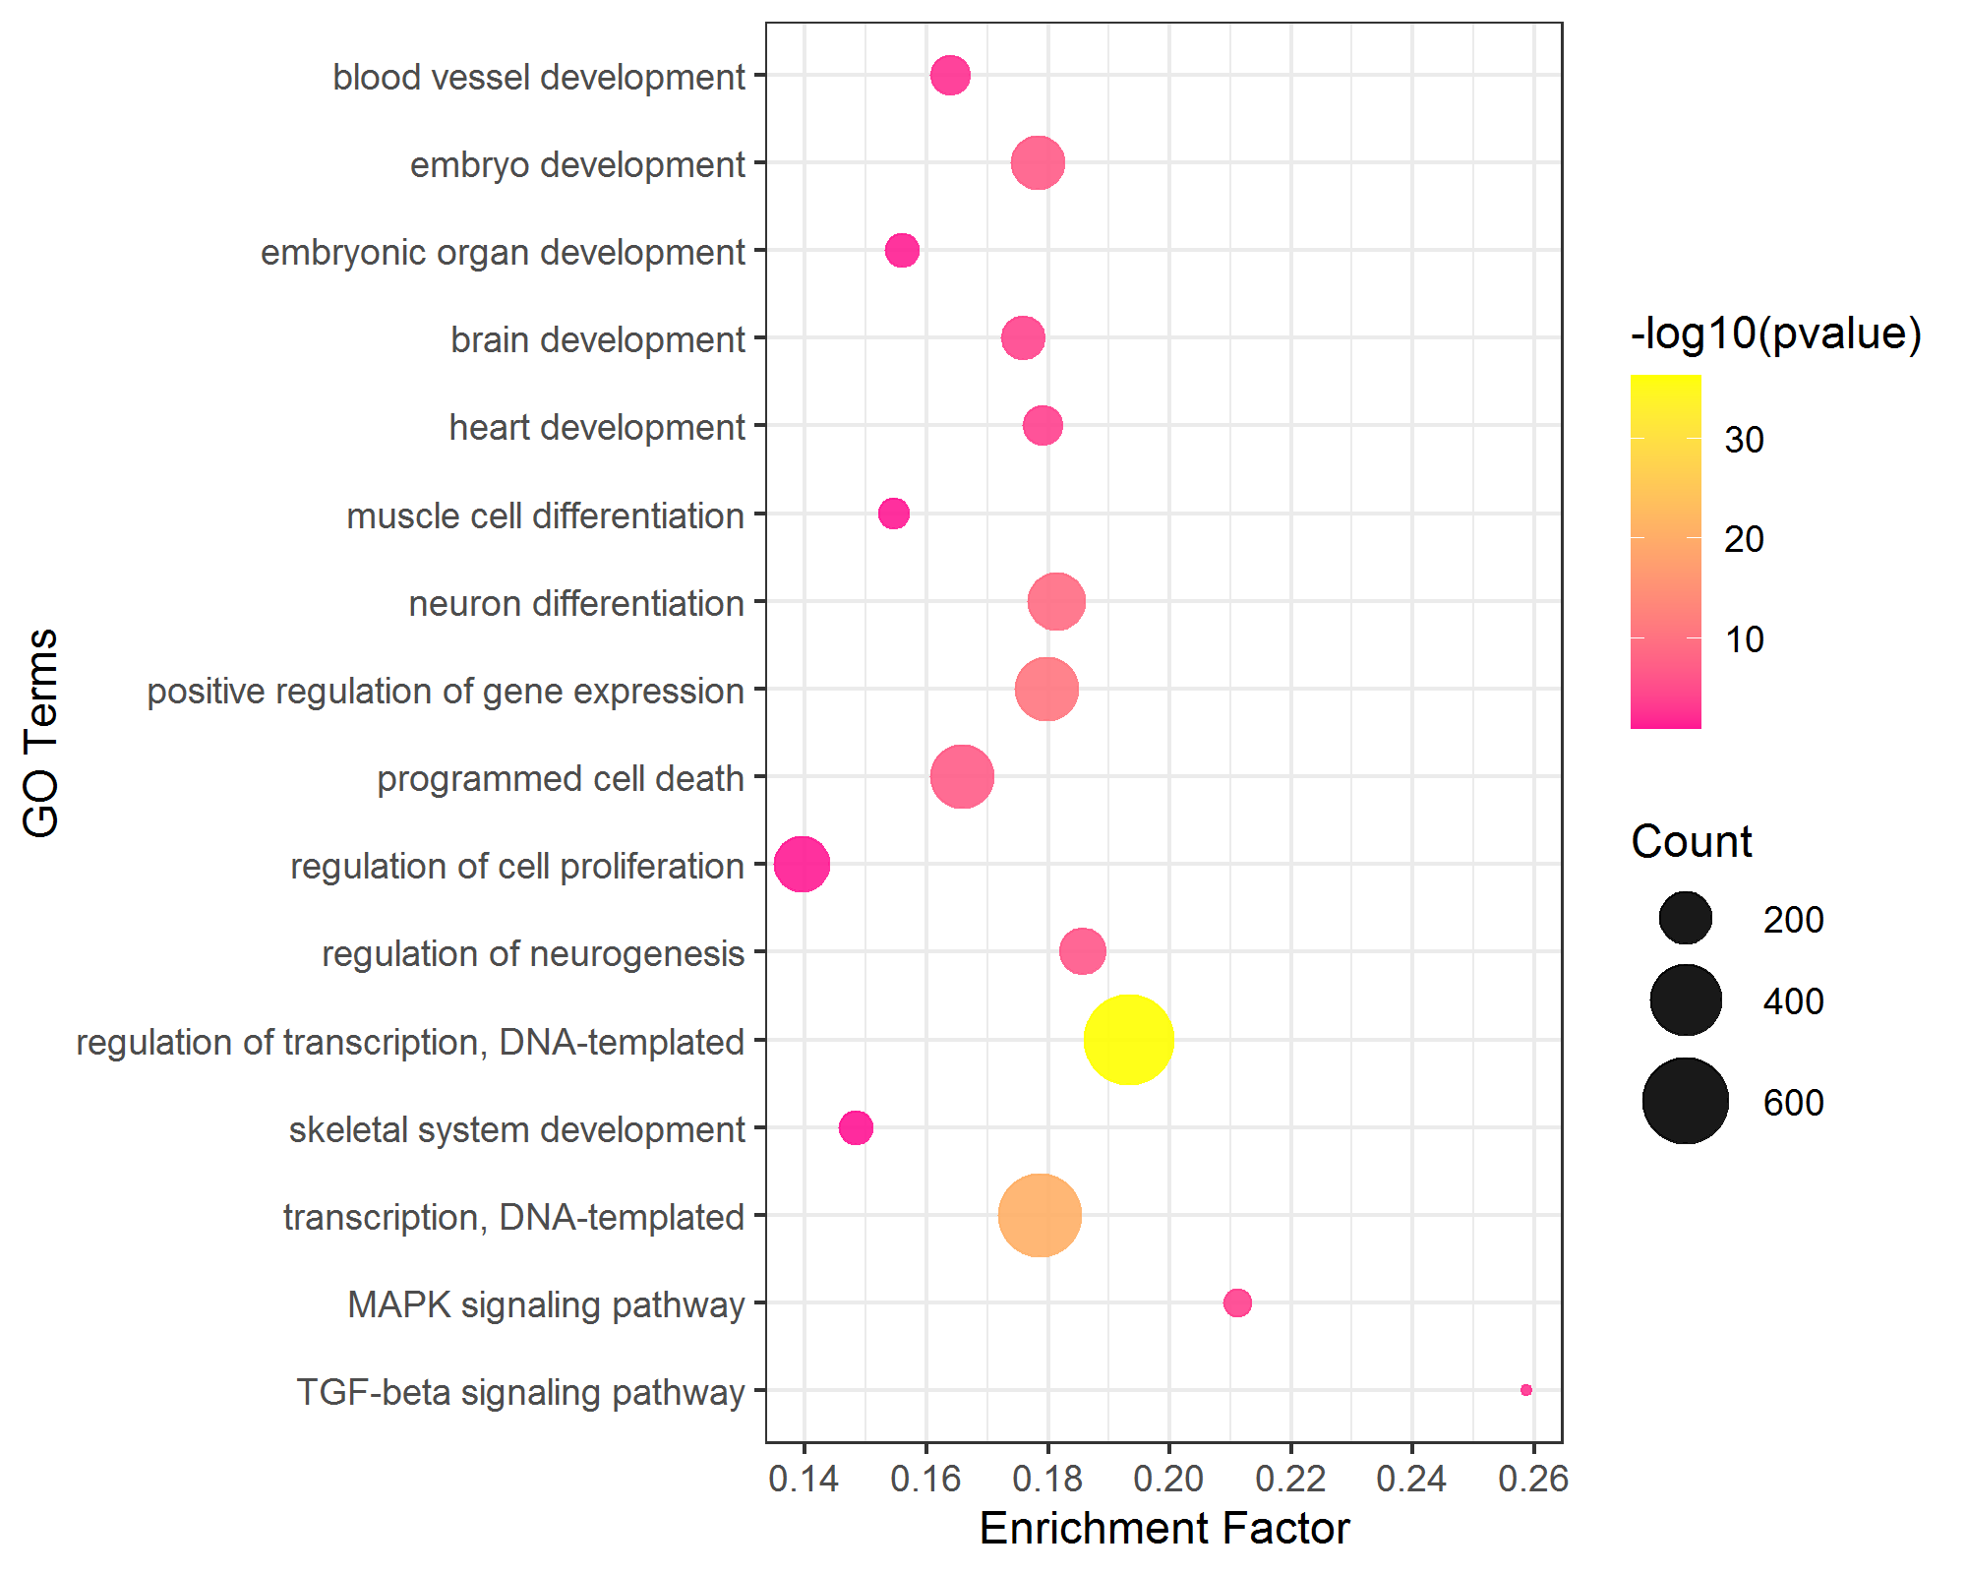
GO enrichment and KEGG pathway analysis of the DEGs at day 6 of differentiation to EBs.

Slide 11
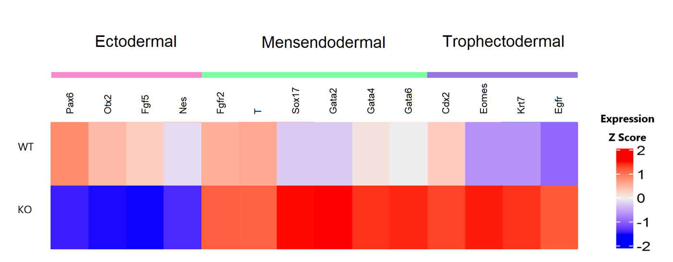
Heatmap: Expression patterns of deregulated lineage marker genes at day 6 of differentiation

Slide 12
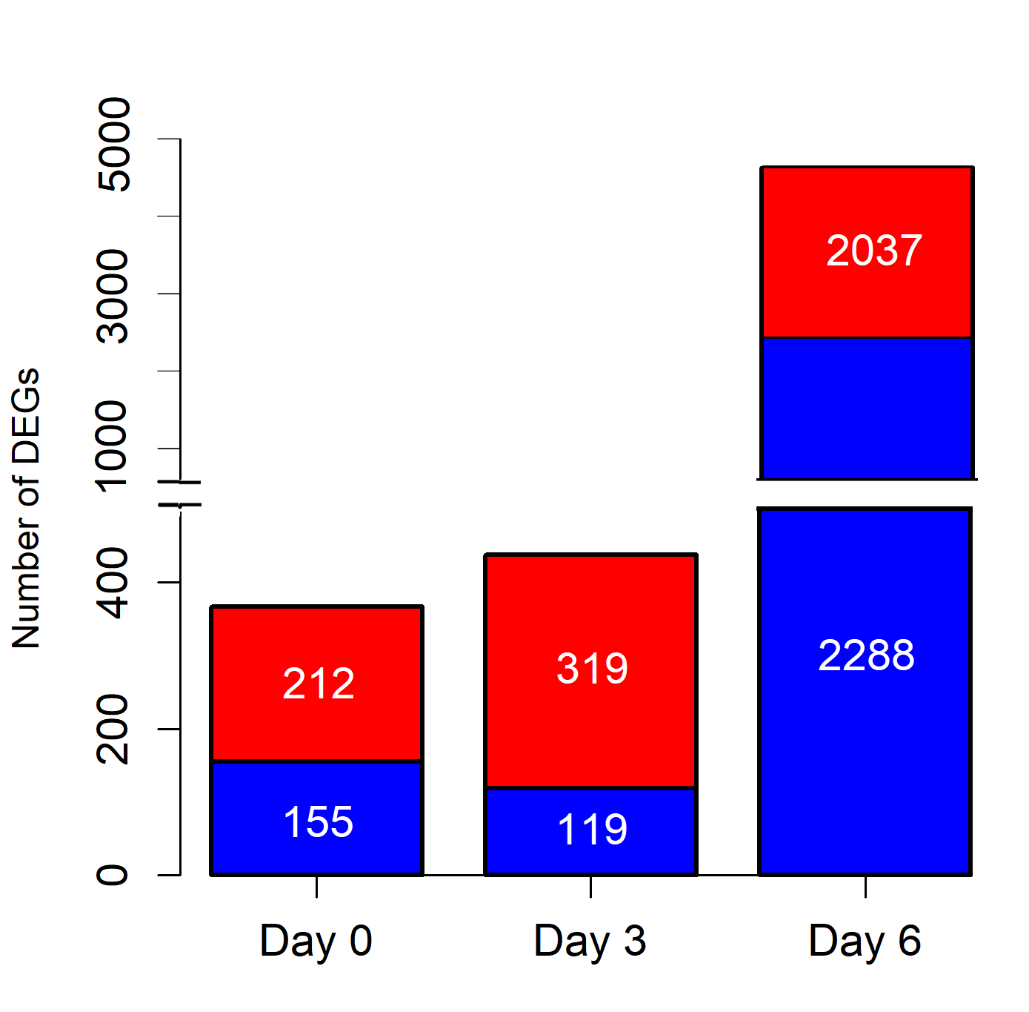
Barplot for Number of DEGs

Slide 13
Names of Excel files of DEGs, Up/Down DEGs
\Rinf\WTDAY0-vs-KODAY0\DEGs.csv (DEGs with all info)
\Rinf\WTDAY0-vs-KODAY0\SigDEGs.csv (Significant DEGs list with all info, FDR < 0.05)
\Rinf\WTDAY0-vs-KODAY0\SigDEGsDownList.tsv (Significant Down DEGs list, FDR < 0.05)
\Rinf\WTDAY0-vs-KODAY0\SigDEGsUpList.tsv (Significant Up DEGs list, FDR < 0.05)
\Rinf\WTDAY3-vs-KODAY3\<same set of files as WTDAY0-vs-KODAY0>
\Rinf\WTDAY6-vs-KODAY6\<same set of files as WTDAY0-vs-KODAY0>

Slide 14
Acknowledgement
Thanks to Dr. Qin Tang for provided the code for RNA-Seq pipeline, gave me instructions, and great help in troubleshooting and heat map generation.

